Slide 1
TATARSTAN
Kazan, Volga and much more

Slide 2
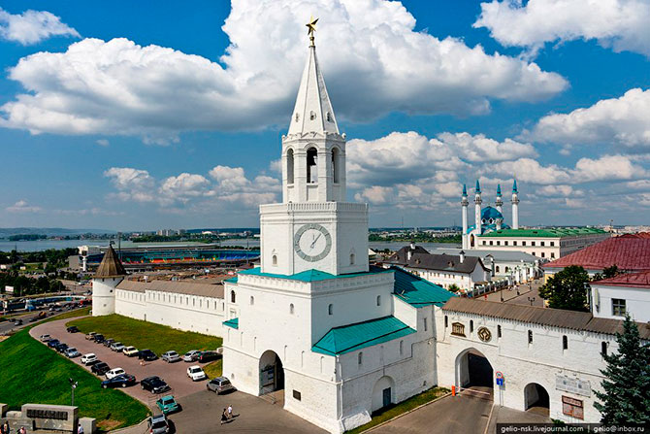
Kazan is the 3rd capital of Russia

Slide 3
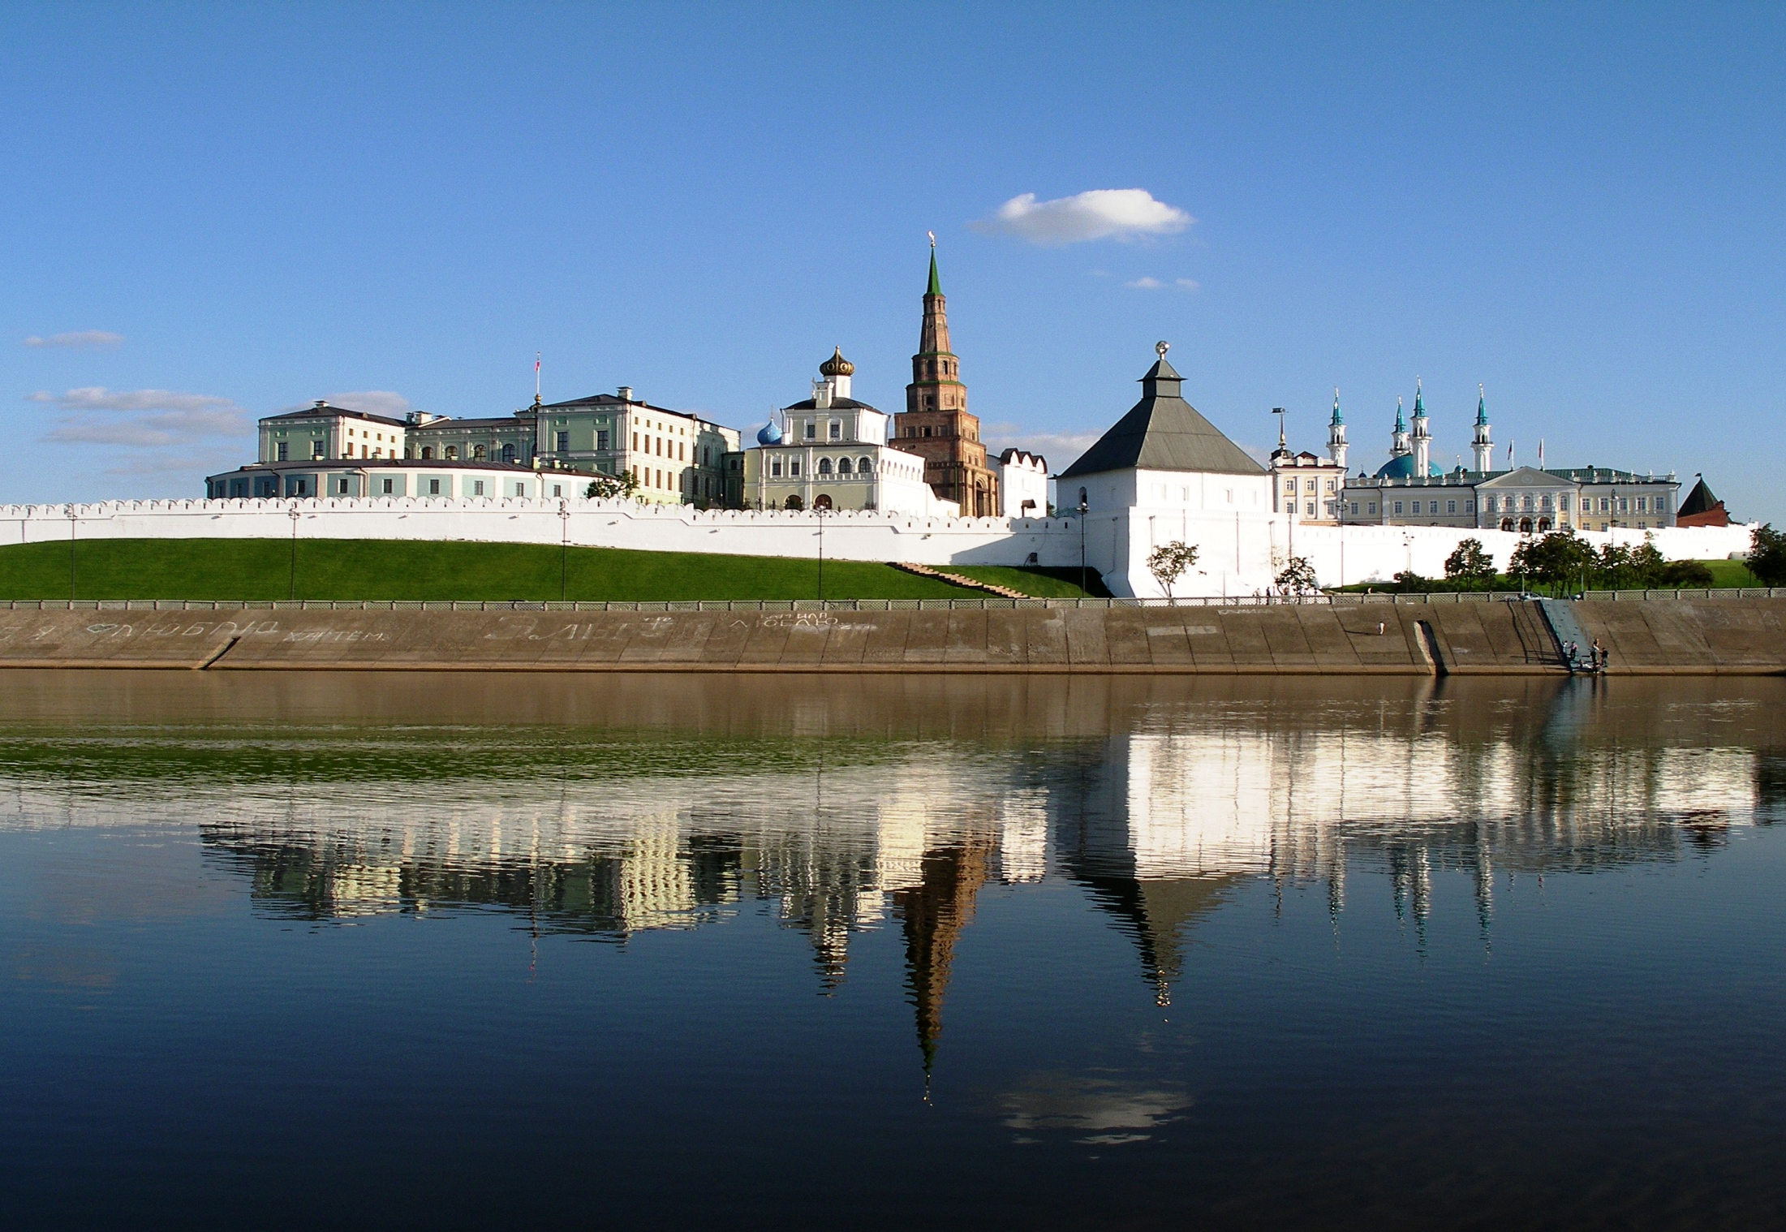
The Kazan Kremlin is a UNESCO
Heritage Object

Slide 4
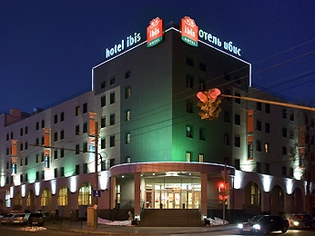
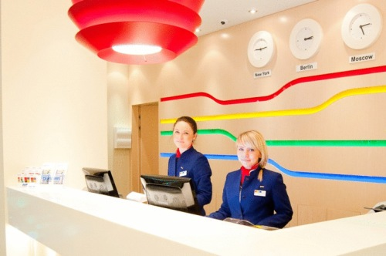
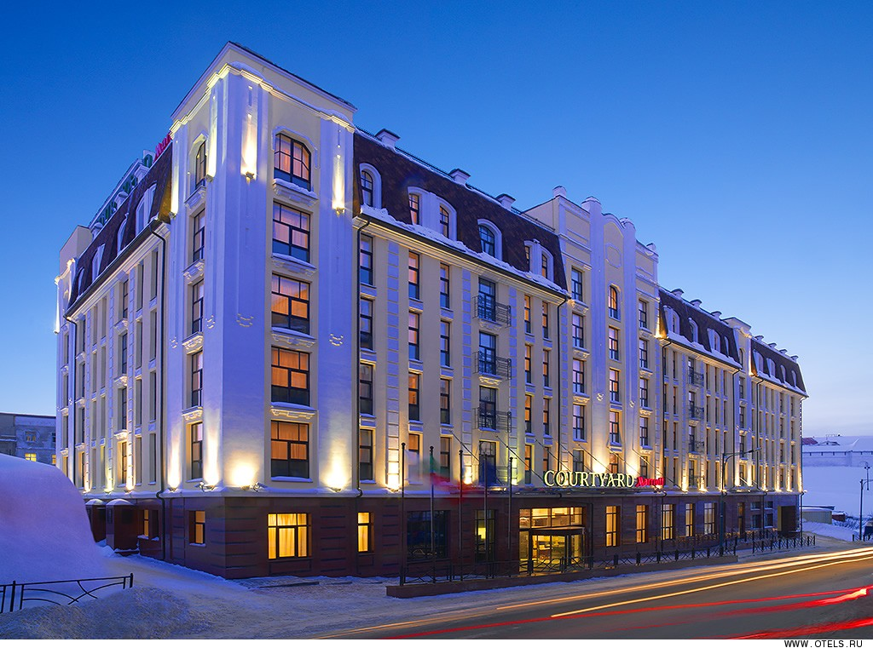
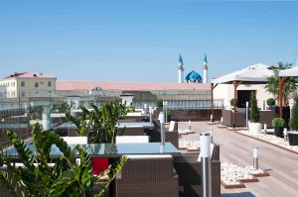
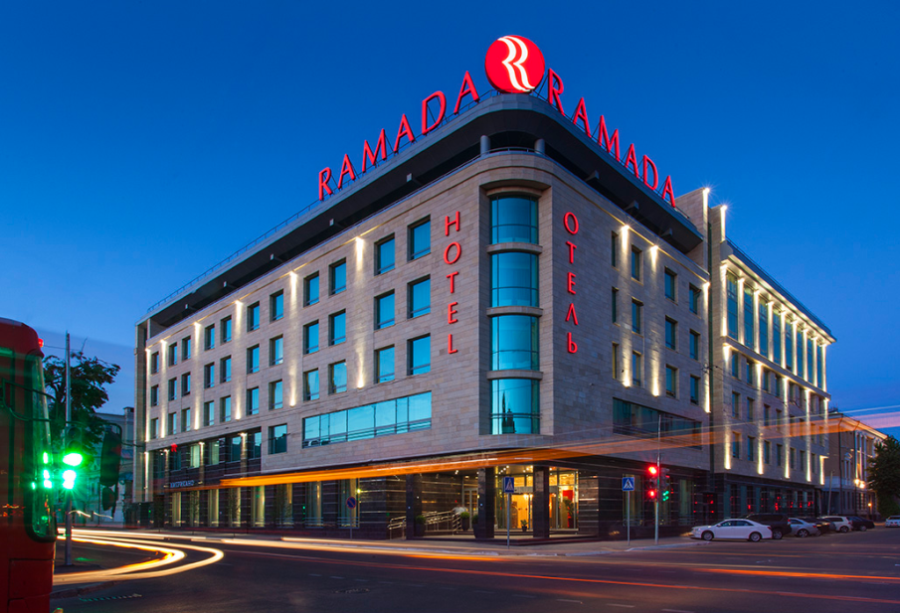
Strong presence of international hotel chains

Slide 5
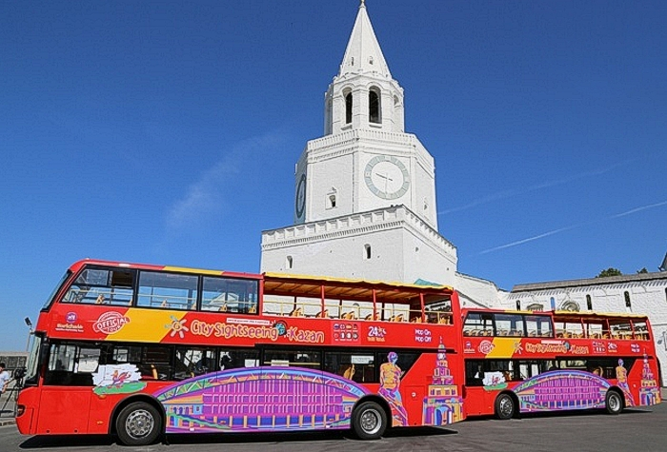
Modern sightseeing services

Slide 6
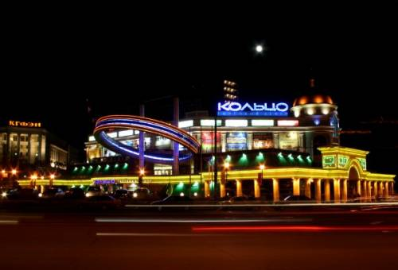
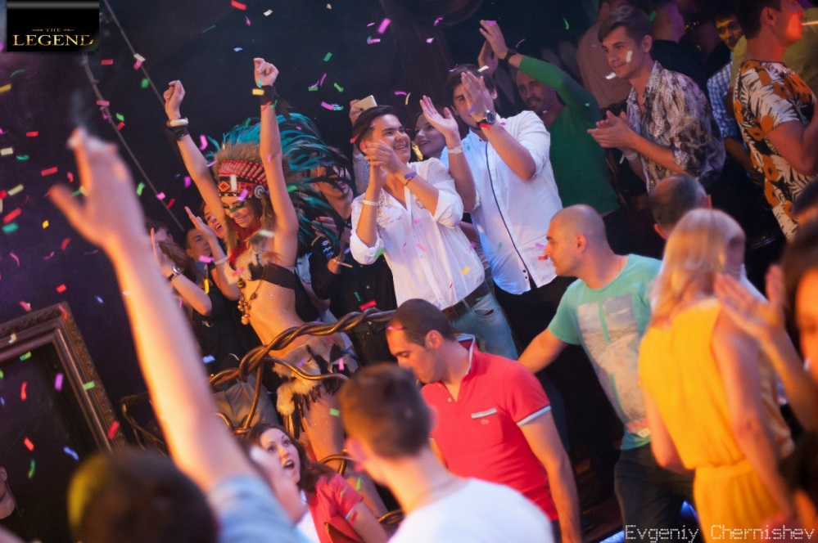
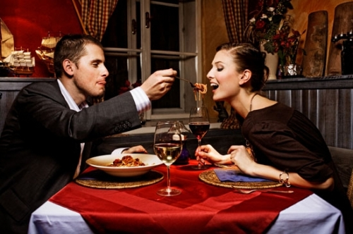
Entertainment and night life

Slide 7
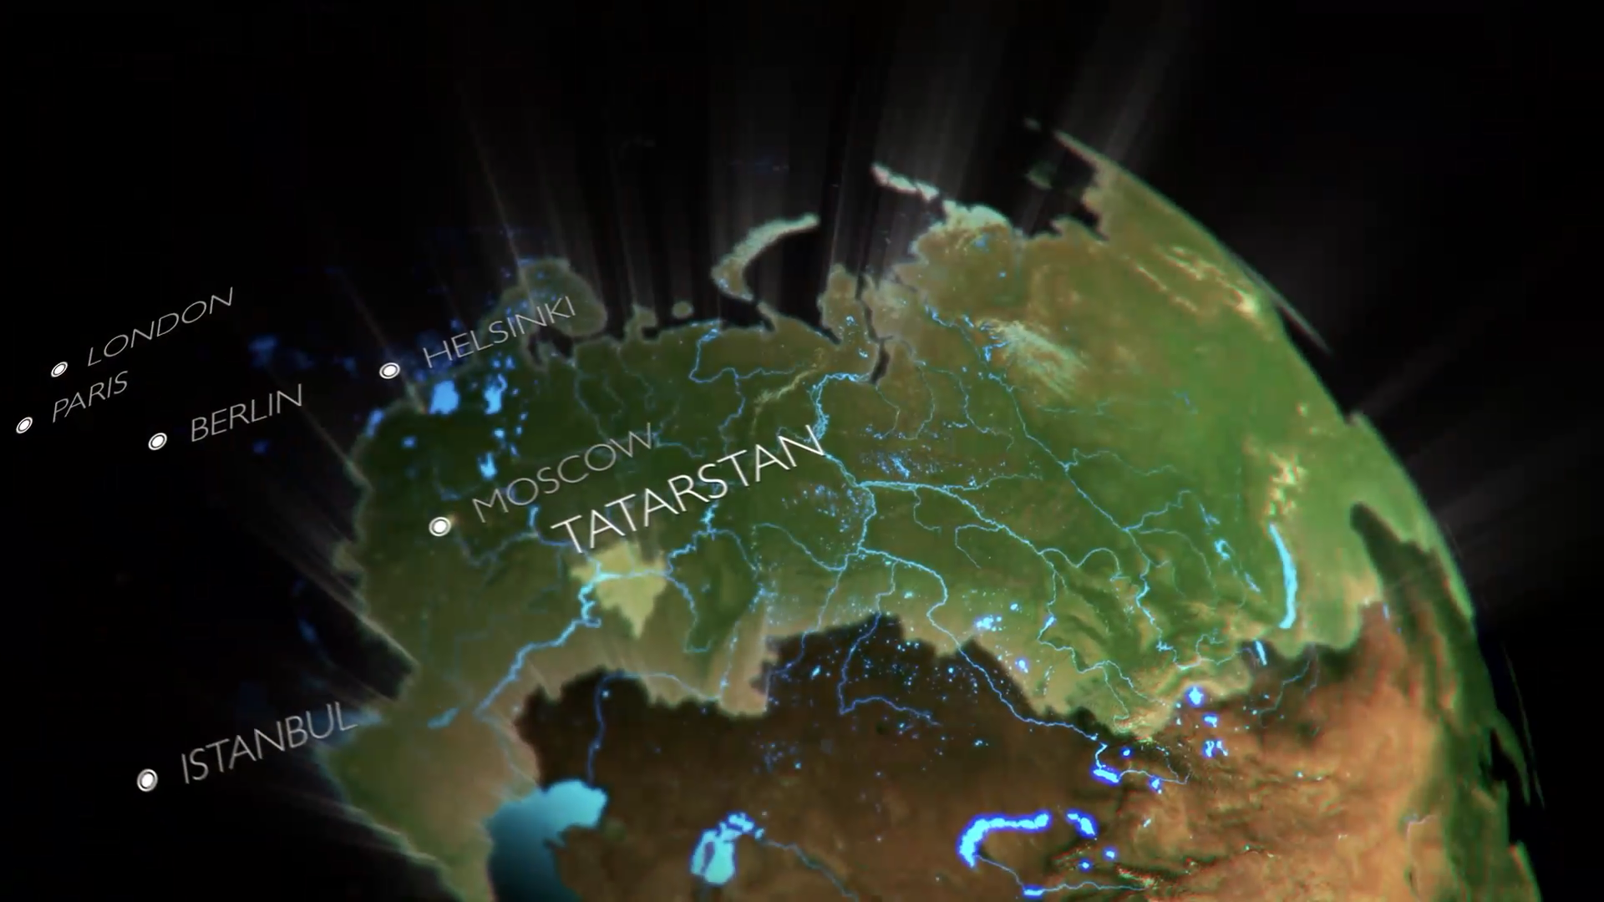
Easy to travel
Kazan – Moscow - 800 km, more than 14 flights per day
Ljubljana – Kazan 7 flight a week through Moscow/Istanbul

Slide 8
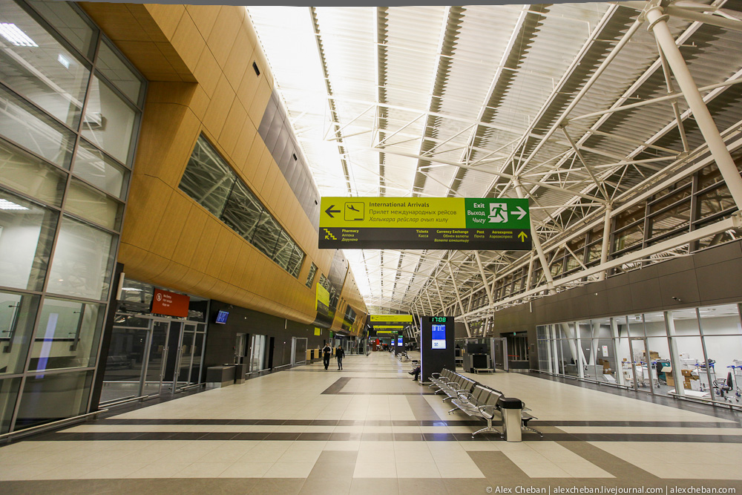
Modern International Airport

Slide 9
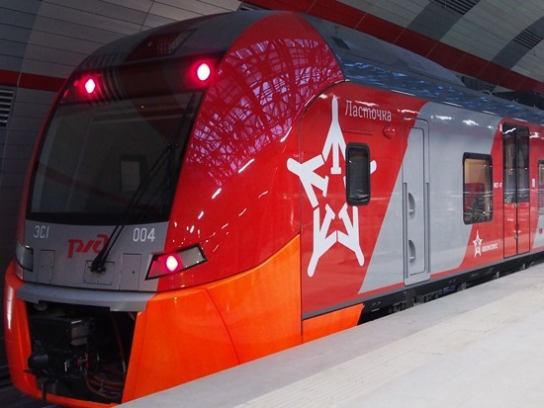
New Aeroexpress Intermodal Train

Slide 10
Companies engaged in tourism
in the Republic of Tatarstan
347 hotels
620 travel companies

Slide 11
Kazan is the third popular tourist
destination in Russia
Tourist flow growth
12-15 % per year
Services provided for
224 million USD

Slide 12
Structure of tourist flow by target groups

Slide 13
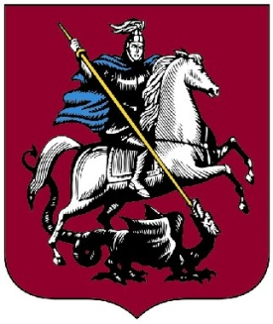
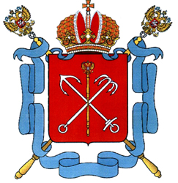
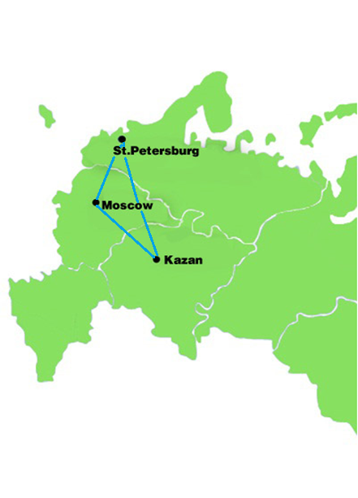
Best way to explore Russia
Three capitals of Russia
Moscow
Saint-Petersburg
Kazan

Slide 14
Ratings - 2014
KAZAN – Top-10 destinations on the rise in the world
TATARSTAN – «The best region
for travel in Russia»

Slide 15
Welcome to Tatarstan
www.GoKazan.com

